Slide 1
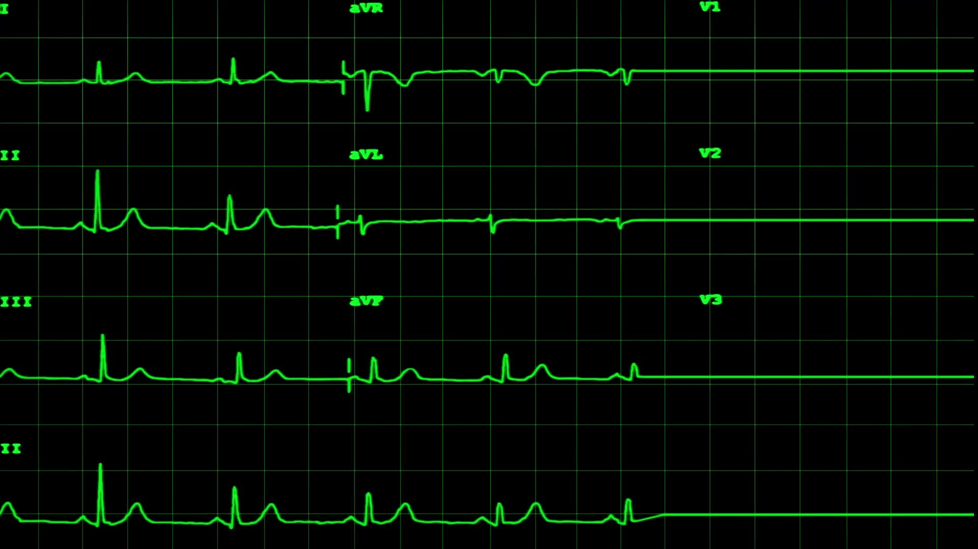
Mortality Prediction for In-Hospital ICU Patients
SAT 5141 Clinical Decision Support Systems
Rishidhar Konathala , Chandu Narasimhareddyvari
Course Project Group 8
Professor: Dr.Guy Hembroff
Michigan Tech College of Applied Computing
03rd December 2024

Slide 2
Introduction
Objective
Goal: Develop machine learning models to predict in-hospital mortality for ICU patients
Data: First 48 hours of ICU admission from MIMIC II database
Dataset Link: PhysioNet Challenge 2012
Proposed models : XG Boost and ANN
Evaluation :Evaluate the model’s performance using key metrics like AUC-ROC, accuracy, and F1-score.
Challenges
Missing Data: Frequent in ICU datasets due to skipped measurements.
Time-Series Processing: ICU metrics often captured as time-series data.
Class Imbalance: Minority class (mortality cases) underrepresented.

Slide 3
Background of the problem
ICU mortality prediction is vital for assessing treatment efficacy, resource allocation, and patient outcomes.
Each year (in the USA)
Over 5 million ICU patients are treated annually in the USA, with mortality rates of 8–19%.
Accurate predictions aid clinicians in care planning and resource management.
Early risk identification reduces complications, optimizes interventions, and lowers costs.
ICU mortality prediction
Traditional scoring systems like APACHE, SAPS, and SOFA rely on manually designed features but have limitations in scalability and accuracy.(https://clincalc.com/IcuMortality/)

Slide 4
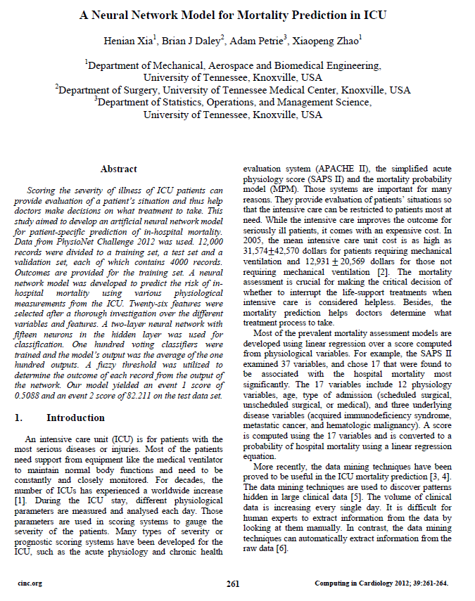
Literature Review
Study developed ANN model to predict in-hospital mortality for ICU patients
Used data from PhysioNet Challenge 2012 (12,000 records)
Selected 26 features from physiological measurements
Model architecture:
Two-layer neural network
15 neurons in the hidden layer
100 voting classifiers used
Techniques employed:
Oversampling of positive (mortality) cases
Fuzzy threshold for classification
Performance:
Event 1 score: 0.5088 on test data
Event 2 score: 82.211 on test data
Key features: GCS, HCO3, BUN, urine output, vital signs
Ref:https://www.cinc.org/archives/2012/pdf/0261.pdf

Slide 5
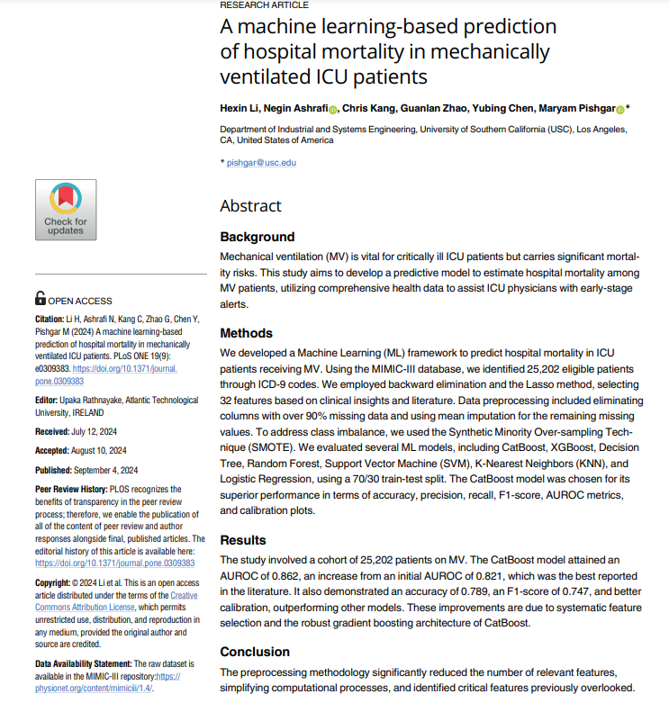
Literature Review
• Study developed ML model to predict mortality in ICU patients on mechanical ventilation
• Used MIMIC-III database with 25,202 eligible patients
• Selected 32 features using backward elimination, Lasso method, and clinical insights
• Addressed class imbalance using SMOTE technique
• Evaluated multiple ML models: CatBoost, XGBoost, Decision Tree, Random Forest, SVM, KNN, Logistic Regression
CatBoost model performed best:
AUROC: 0.862
Accuracy: 0.789
F1-score: 0.747
• Improved upon the previous best-reported AUROC of 0.821
• Model shows potential to enhance resource allocation and personalized interventions in ICUs
Ref:https://pubmed.ncbi.nlm.nih.gov/39231126/

Slide 6
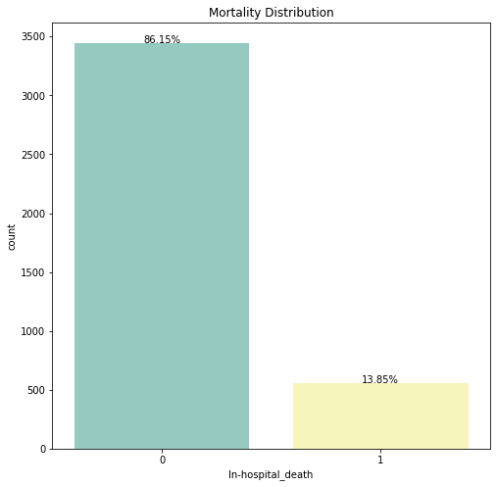
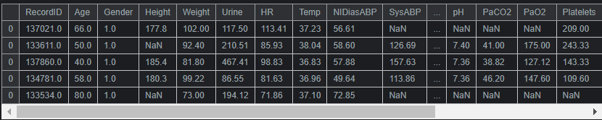
Dataset
Size: 12,000+ ICU admissions
Time Frame: First 48 hours of ICU stay
Data Types: • Demographic: age, gender, height, ICU type, and initial weight • Physiological: vital signs, lab metrics (time series)
Outcome: Binary in-hospital death (target class (`In-hospital_death`))
Key Features: • 5 demographic descriptors • 36 physiological time series • APACHE, SAPS, and SOFA
Class Distribution: 13.85 % mortality rate

Slide 7
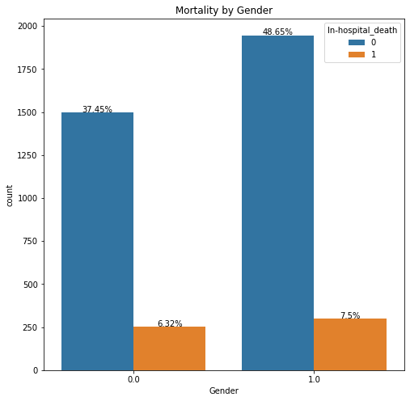
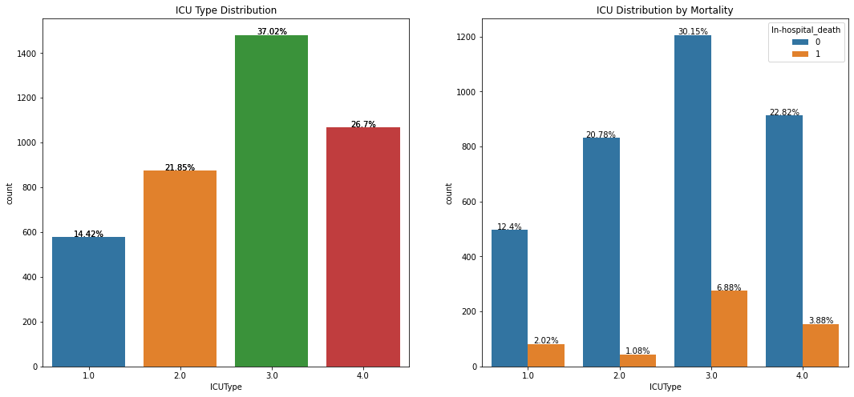
Data Distribution
Visualizing Data Distributions

Slide 8
Handling Missing Values
Imputed missing physiological and lab values using mean imputation.
Median imputation for height and weight due to skewed distributions.
Mortality Distribution
Analyzed ICU mortality distribution:
Observation: Mortality rates were consistent across genders but varied significantly by age and BMI.
ICU Type 3 and 4 patients exhibited higher mortality.
Age Distribution
ICU patients skew older; higher mortality rates observed in age groups above 60 years.
BMI Analysis
Trends:
Higher mortality rates among patients with BMI categorized as Underweight or Obese.
Gender disparity observed, with more males admitted than females.
Preprocessing

Slide 9
Standardization
Scaled continuous variables to ensure consistent scaling across features.
Encoding
Categorical variables (e.g., ICU type, gender) encoded using label encoding.
Class Imbalance :
Class Imbalance is handled to ensure that the model doesn’t favor the majority class, which is critical for healthcare applications where identifying rare outcomes like mortality is crucial.
Addressed using techniques like SMOTE (Synthetic Minority Over-sampling Technique).
and oversampling.
Preprocessing (cont..)

Slide 10
Model Development
Artificial Neural Network (ANN)
Architecture:
A feed-forward neural network designed for binary classification tasks.
Captures complex, non-linear relationships in ICU patient data.
Layers:
Input Layer: Takes preprocessed features (22 features from ICU data) as input.
Hidden Layers:
Dense Layer 1: 20 units, ReLU activation.
Dense Layer 2: 40 units, ReLU activation.
Dense Layer 3: 80 units, ReLU activation.
Dense Layer 4: 40 units, ReLU activation.
Dense Layer 5: 20 units, ReLU activation.
Output Layer:
Dense Layer 6: 1unit, Sigmoid activation (outputs mortality probability).

Slide 11
Model Development
XGBoost Classifier
Input Layer:
Takes preprocessed features (e.g., ICU data with 22 features) as input.
Base Learner:
Decision Trees:
Trees are built sequentially, with each tree focusing on correcting errors (residuals) from previous trees.
Maximum tree depth: 5 (controls complexity).
Ensemble Learning:
Combines predictions from 100 decision trees using gradient boosting.
Optimized to minimize the binary logistic loss function.
Regularization:
L1 and L2 regularization to prevent overfitting.
Learning rate: 0.1 to control the contribution of each tree.
Output Layer:
Produces the final prediction by summing weighted outputs of all trees.
Applies a logistic transformation for binary classification (In-hospital_death probability).

Slide 12
Model Training
ANN Model :
Epochs: 100
Batch Size: 32
Learning Rate: (default Adam learning rate)
Optimizer: Adam
Loss Function: Binary Cross-Entropy (BCE)
Metrics: Accuracy
Class Weights: Optionally applied (if weights ≠ -1)
XG Boost :
n_estimators: 100 decision trees used for boosting.
Learning Rate: 0.1 (controls the contribution of each tree).
Max Depth: 5 (limits tree depth to prevent overfitting).
Random State: 42
Objective: Binary logistic regression for mortality classification.
Feature Importance: Extracts and ranks critical features influencing predictions.

Slide 13
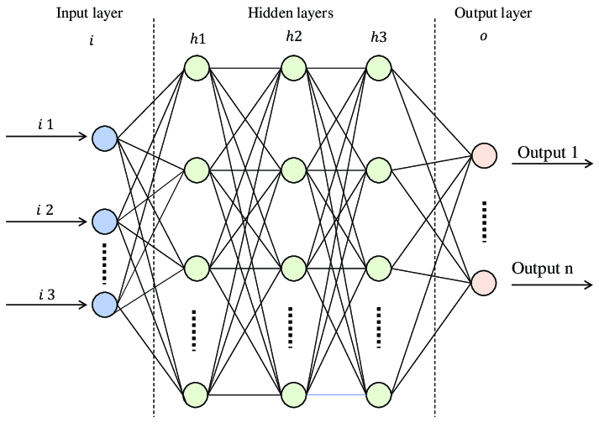
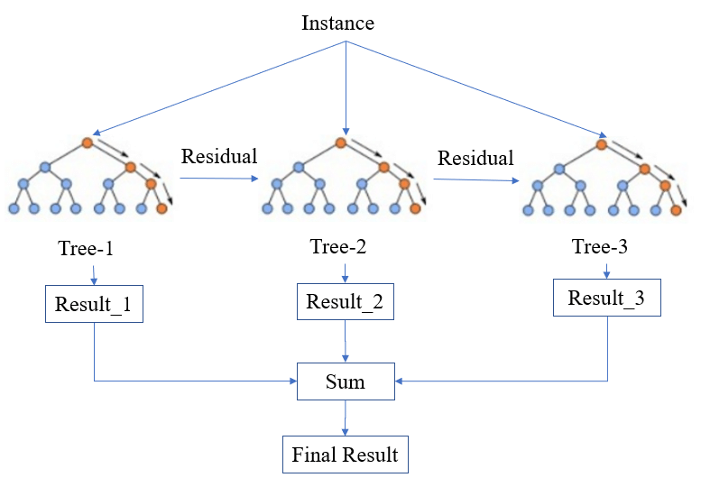
Architecture Overview
FNN
XG Boost

Slide 14
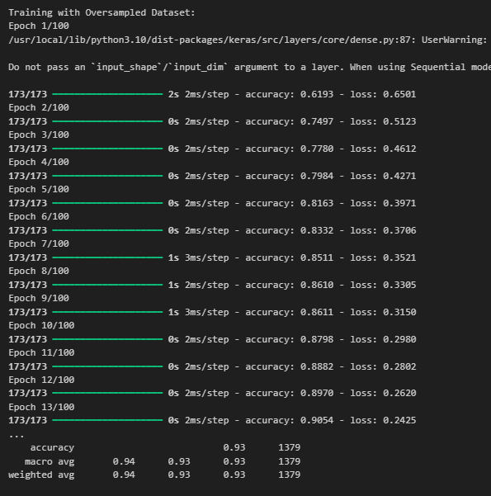
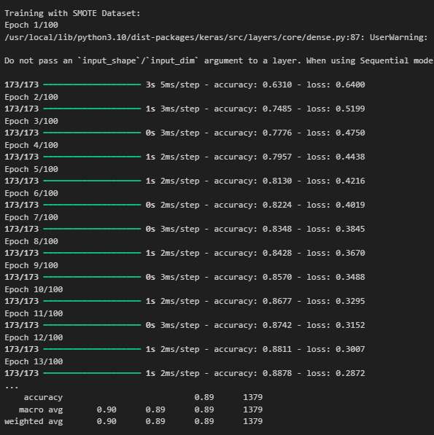
Performance Metrics : Artificial Neural Networks (ANN)

Slide 15
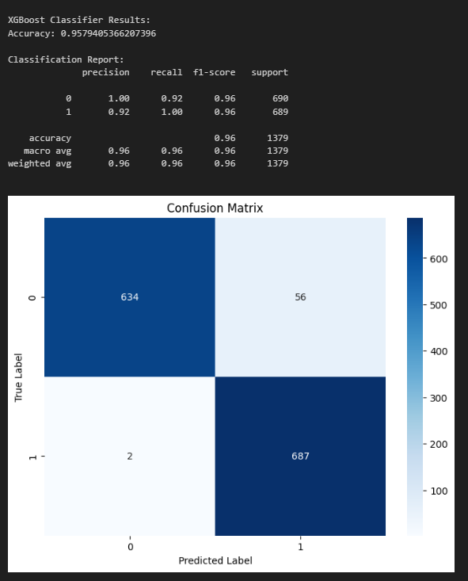
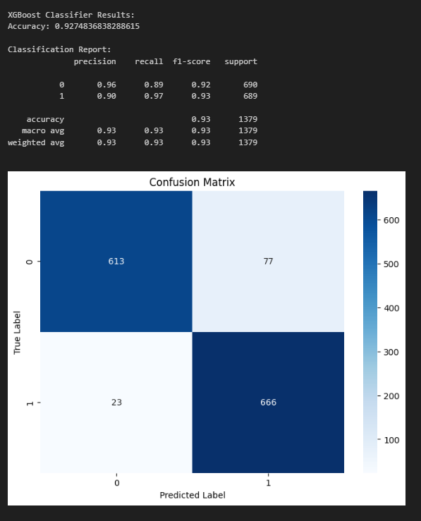
XGboost classifier:
XGboost on oversampled data XGboost on Smote data

Slide 16
Results
XGBoost classifier
ANN
Accuracy:
Oversampled: 0.95
Smote: 0.93
Precision:
Oversampled: 1
Smote: 0.92
Recall:
Oversampled: 0.92
Smote: 0.89
F-1 score:
Oversampled: 0.96
Smote: 0.96
Accuracy:
Oversampled: 0.93
Smote: 0.89
Precision:
Oversampled: 0.88
Smote: 0.85
Recall:
Oversampled: 0.86
Smote: 0.95
F-1 score:
Oversampled: 0.92
Smote: 0.90

Slide 17
Limitations:
Dataset challenges:
Smaller dataset which may restrict generalizability.
Handling of missing values might lead to bias.
Class imbalance and model interpretability:
Despite using SMOTE technique, minority class prediction might still be suboptimal.
ANN and XGBoost lack intuitive interpretability, making clinical application challenging.
Limitations and Future work

Slide 18
Future work
Enhance Interpretability:
Implement interpretable models like decision trees or logistic regression for explainable predictions alongside ANN and XGBoost.
Using attention mechanisms in neural networks to highlight critical features.
Dynamic Data Utilization:
Expansion of the scope to include real-time ICU data streams to predict mortality trends dynamically.
Integration of continuous patient monitoring data for richer insights.
Bias Mitigation:
Investigate potential biases in model predictions, such as demographic or socio-economic disparities.
Incorporate fairness metrics to evaluate the impact of the models on diverse patient groups.
Incorporate Additional Predictors:
Consider non-physiological factors like treatment regimens, ICU staffing, and patient histories to improve model accuracy.
Include genomics or biomarkers if available for personalized risk assessment.

Slide 19
Conclusion
Upon comparing the models, XGBoost demonstrated superior precision and interpretability, making it ideal for scenarios requiring faster inference and clear, explainable results. Conversely, ANN outperformed in recall and AUC-ROC, making it more suitable for healthcare applications prioritizing sensitivity to mortality risk, particularly in critical care.
Integrating XGBoost and ANN within an ensemble framework could harness their complementary strengths. Continued research on enhancing explainability and seamless integration with real-time ICU systems is crucial for developing actionable clinical decision-support tools.
In summary, while both models performed well, XGBoost exhibited better overall performance on the given dataset.

Slide 20

Thank You

